Slide 1

Lecture 1 Introduction and descriptive statistics
Faculty of Computer Science
Data Analysis
Moscow 2022
Lecturer: Alisa Melikyan, amelikyan@hse.ru, PhD,
Associate Professor of the School of Software Engineering

Slide 2
Course Objectives
Data Analysis
Lecture 1
Introduction
give students an introduction to the most widely used quantitative data analysis methods;
explain the data analysis methods using real data and concentrating on complications that may occur during the analysis in real-life research;
teach students how to organize their own research project using the knowledge obtained during the course;
explain how to use data analysis tools in the most effective way to perform the research tasks.

Slide 3
Main topics
Data Analysis
Lecture 1
Introduction
Introduction to data analysis;
Descriptive statistics;
Investigating relationships between variables;
Regression analysis;
Factor analysis;
Cluster analysis;
Panel data analysis;
Time series analysis.

Slide 4
Grading System
Data Analysis
Lecture 1
Introduction
Final grade = 0.15 * Control Work 1 + 0.15 * Control Work 2 + 0.3 * Examination Work + 0.2 * Research Project + 0.2 * Regular tasks
If more than 50% of the control tasks are completed, the student may be exempted from taking the exam. In this case, the formula for calculating the final grade is as follows:
Final grade = 0.2 * Control Work 1 + 0.2 * Control Work 2 + 0.3 * Research Project + 0.3 * Regular tasks

Slide 5
Data Sources
Data Analysis
Lecture 1
Introduction
Kaggle: Your Machine Learning and Data Science Community​ https://www.kaggle.com
​Statistical resources of the World Bank and the Organization for Economics Co-operation and Development https://library.hse.ru/e-resources
Joint economical and sociological data archive http://sophist.hse.ru/eng/

Slide 6
Data Analysis Tools
Data Analysis
Lecture 1
Introduction
Python 3
The Anaconda distribution contains a Python interpreter and a Jupyter Notebook instance. We will use Jupyter Notebook interactive development environment.
https://www.anaconda.com/products/individual-d
Google Colab (interactive cloud environment for working with code)
https://colab.research.google.com/

Slide 7
Data Structures
Data Analysis
Lecture 1
Introduction
Cross-sectional data
Time series data
Panel data

Slide 8
Cross-Sectional Data
Data Analysis
Lecture 1
Introduction
Cross-sectional data, or a cross section of a study population, in statistics and econometrics is a type of data collected by observing many subjects (such as individuals, firms, countries, or regions) at the one point or period of time.
Variables
company_id | country | employees | income
324 | Russia | 2540 | 450000
332 | USA | 5232 | 443000
643 | France | 3451 | 322600
435 | Russia | 436 | 33256
532 | Canada | 325 | 43454
Cases

Slide 9
Cross Section: data structure
Data Analysis
Lecture 1
Introduction
Rows are cases. Each row represents a case or an observation.
Columns are variables. Each column represents a variable or characteristic being measured.
Cells contain values. Each cell contains a single value of a variable for a case.

Slide 10
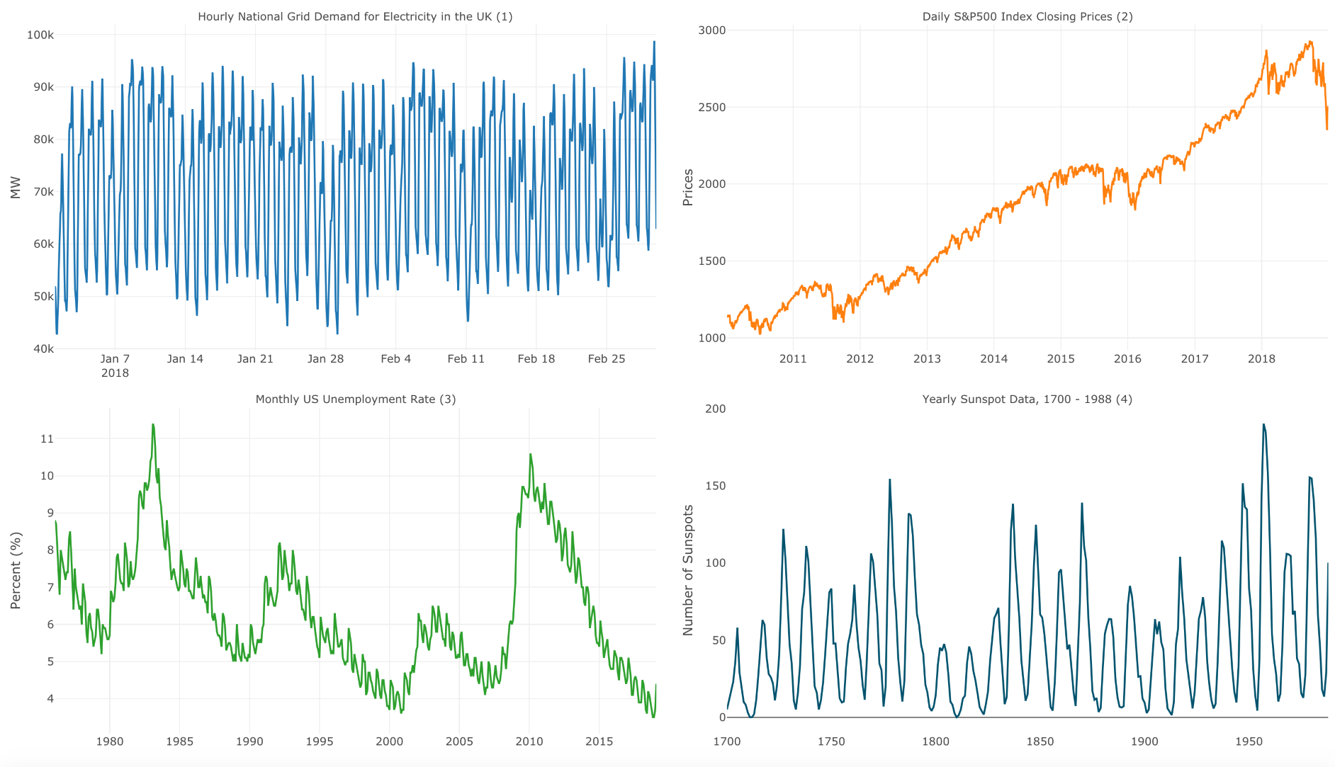
Time Series Data
Data Analysis
Lecture 1
Introduction
Time series is a series of data points indexed in time order. Most commonly, a time series is a sequence taken at successive equally spaced points in time.

Slide 11
Panel Data
Data Analysis
Lecture 1
Introduction
Panel Data or Longitudinal Data are multi-dimensional data involving measurements over time. Panel data contain observations of multiple phenomena obtained over multiple time periods for the same objects.
Panel data have three dimensions:
variables,
cases,
time.

Slide 12
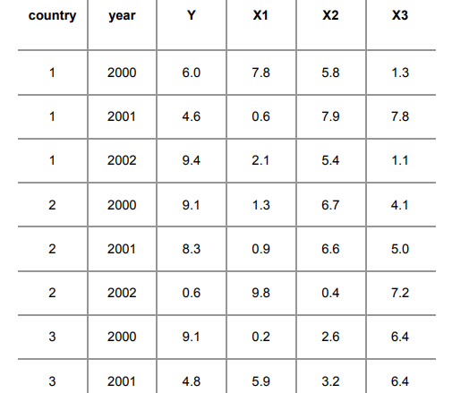
Example of panel data
Data Analysis
Lecture 1
Introduction

Slide 13
Continuous and Categorical variables
Data Analysis
Lecture 1
Introduction
Continuous (or Scale) Variables – data values are numeric values on an interval or ratio scale (e.g., age, income).
Categorical Variables – variables that have values which fall into two or more discrete categories. E.g. male or female, employment category, country of origin
Two types of Categorical variables: Ordinal & Nominal

Slide 14
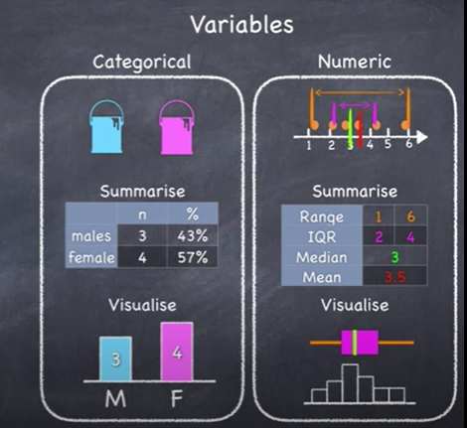
Data Analysis
Lecture 1
Introduction
Source: https://www.youtube.com/watch?v=I10q6fjPxJ0&t=441s

Slide 15
Nominal Scale
Data Analysis
Lecture 1
Introduction
Data values represent categories with no intrinsic order, sequence of categories is arbitrary – ordering has no meaning in and of itself:
country of origin: Wales, Scotland, Germany…
car manufacturers: Kia, Tesla, Mazda
job category: manager, it-specialist, cleaner
company department: production, purchasing, HR, R&D
Nominal variables can be either string (alphanumeric) or numeric values that represent distinct categories (e.g., 1=Male, 2=Female).

Slide 16
Ordinal Scale
Data Analysis
Lecture 1
Introduction
Values fall within discrete but ordered categories, the sequence of categories has meaning.
Education categories: 1 = primary, 2 = secondary, 3 = college, 4 = university undergraduate, 5 = university postgraduate masters, 6 = university postgraduate PhD
Wealth level: 1= very poor, 2= poor, 3=good, 4=very good
Satisfaction level (Likert scale): 1 = very satisfied, 2 = somewhat satisfied, 3 = neither satisfied nor dissatisfied, 4 = somewhat dissatisfied, 5 = very dissatisfied

Slide 17
Interval Scale
Data Analysis
Lecture 1
Introduction
Interval Scale is defined as a numerical scale where we can express and compare numerically the differences between the values. Interval scales hold no true zero and can represent values below zero. For example, you can measure temperature below 0 degrees Celsius, such as -10 degrees. For example, sea water temperature in Celsius in the morning is 18 degrees, in the evening is 24 degrees, i.e. in the evening it’s 5 degrees higher, but it cannot be said that it is 1.33 times higher.

Slide 18
Ratio Scale
Data Analysis
Lecture 1
Introduction
Ratio variables never fall below zero. Height and weight measure from 0 and above, but never fall below it. A ratio scale has the same properties as interval scales. You can use it to add, subtract, or count measurements. Ratio scales differ by having a character of origin, which is the starting or zero-point of the scale.

Slide 19
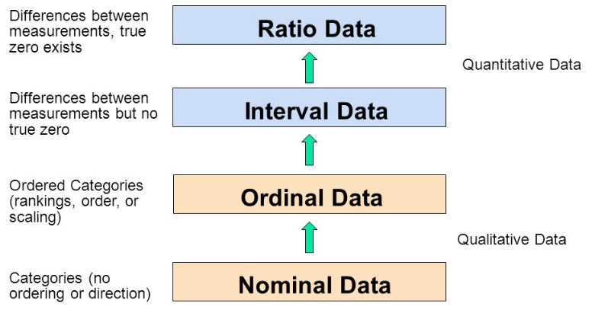
Measurement Scales
Data Analysis
Lecture 1
Introduction
Source: https://www.graphpad.com/support/faq/what-is-the-difference-between-ordinal-interval-and-ratio-variables-why-should-i-care/

Slide 20
Multiple-choice questions
Data Analysis
Lecture 1
Introduction
If a question supposes a possibility to choice more than one answer more than one variables should be created. The number of variables that needs to be created depends on the data encoding method.
Example of a multiple-choice question:
Select the languages you know (several answers could be chosen)
English
Russian
French
Italian
German
Other

Slide 21
Multiple-choice questions: dichotomous approach
Data Analysis
Lecture 1
Introduction
Answers:
Dave: English, German
Ann: Russian
Peter: English, French, Italian, German
Oliver: Russian, German
Select the languages you know:
1) English
2) Russian
3) French
4) Italian
5) German
Name | Lan_en | Lan_ru | Lan_fr | Lan_it | Lan_ge
Dave | 1 | 0 | 0 | 0 | 1
Ann | 0 | 1 | 0 | 0 | 0
Peter | 1 | 0 | 1 | 1 | 1
Oliver | 0 | 1 | 0 | 0 | 1

Slide 22
Multiple-choice questions: categorical approach
Data Analysis
Lecture 1
Introduction
Answers:
Dave: English, German
Ann: Russian
Peter: English, French, Italian, German
Oliver: Russian, German
Select the languages you know:
(you can choose any number of answers
/ select up to 4 options)
1) English
2) Russian
3) French
4) Italian
5) German
Name | Lan_1 | Lan_2 | Lan_3 | Lan_4
Dave | 1 | 5
Ann | 2
Peter | 1 | 3 | 4 | 5
Oliver | 2 | 5

Slide 23
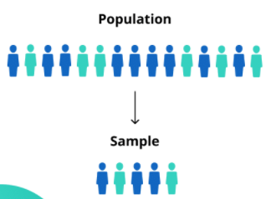
Population and Sample
Data Analysis
Lecture 1
Introduction
Population is the entire group that the researcher wants to draw conclusions about.
Sample is the specific group that the researcher will collect data from. The size of the sample is always less than the total size of the population.

Slide 24
Reasons for Sampling
Data Analysis
Lecture 1
Introduction
It’s sometimes impossible to study the whole population due to its size or inaccessibility.
It’s easier and more efficient to collect data from a sample.
Less resources are required to realize the research.

Slide 25
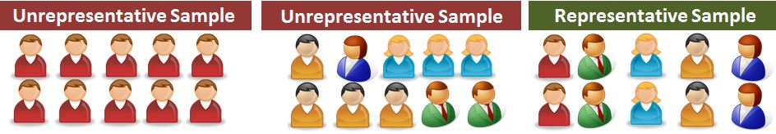
Selecting a Sample
Data Analysis
Lecture 1
Introduction
Ideally, a sample should be randomly selected and representative of the population.
Probability sampling like simple random sampling reduces the risk of sampling bias and enhances both internal and external validity.
Non-probability sampling could be used if the research is less concerned with generalizability. Non-probability samples are chosen for specific criteria, they may be more convenient or cheaper to access.

Slide 26
Population parameter and sample statistic
Data Analysis
Lecture 1
Introduction
Parameter is a measure that describes the whole population. Statistic is a measure that describes the sample.
We can use estimation or hypothesis testing to estimate how likely it is that a sample statistic differs from the population parameter.

Slide 27
Descriptive Statistics
Data Analysis
Lecture 1
Descriptive Statistics
Descriptive Statistics quantitatively describes the main features of the collected data. The aim of Descriptive Statistics is to provide simple summaries about the sample and the measures. Together with simple graphics analysis, they form the basis of quantitative analysis of data.
It also can be used for data screening, especially when a considerable number of cases are being studied.

Slide 28
Univariate analysis
Data Analysis
Lecture 1
Descriptive Statistics
Univariate analysis is aimed at the examination across cases of a single variable, focusing on three characteristics:
distribution;
central tendency;
dispersion.
It is common to compute all three for each study variable.

Slide 29
Distribution
Data Analysis
Lecture 1
Descriptive Statistics
The distribution is a summary of the frequency of individual or ranges of values for a variable. The simplest distribution would list every value of a variable and the number of cases who had that value.
For instance, computing the distribution of gender in the study population means computing the percentages that are male and female. The gender variable has only two values making it possible and meaningful to list each one.
Male – 35 – 60,3%
Female – 23 – 39,7%
If it’s a scale variable, for example, income that has many possible values it’s advised to group the scores using ranges of values in order to reduce the number of categories and create ordinal variable. For instance, we might group incomes into ranges of 0-10 000, 10 001-30 000, etc.

Slide 30
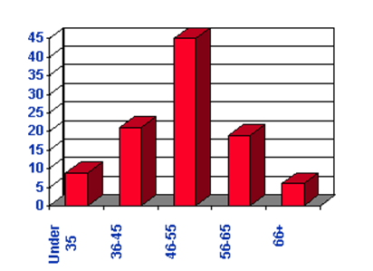
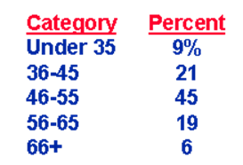
Frequency Analysis
Data Analysis
Lecture 1
Descriptive Statistics
Is most often used in the analysis of the values of categorical variables.
Frequency distribution table
Frequency distribution bar chart

Slide 31
Central Tendency
Data Analysis
Lecture 1
Descriptive Statistics
The central tendency of a distribution locates the "center" of a distribution of values. Three major types of estimates of central tendency: mean, median, mode.
Measurement Scale | Appropriate central tendency estimates
Nominal | mode
Ordinal | mode, median
Scale | mode, median, mean

Slide 32
Mode
Data Analysis
Lecture 1
Descriptive Statistics
The mode is the most frequently occurring value in the set. In some distributions there are multiple modal values. These are called multi-modal distributions.

Slide 33
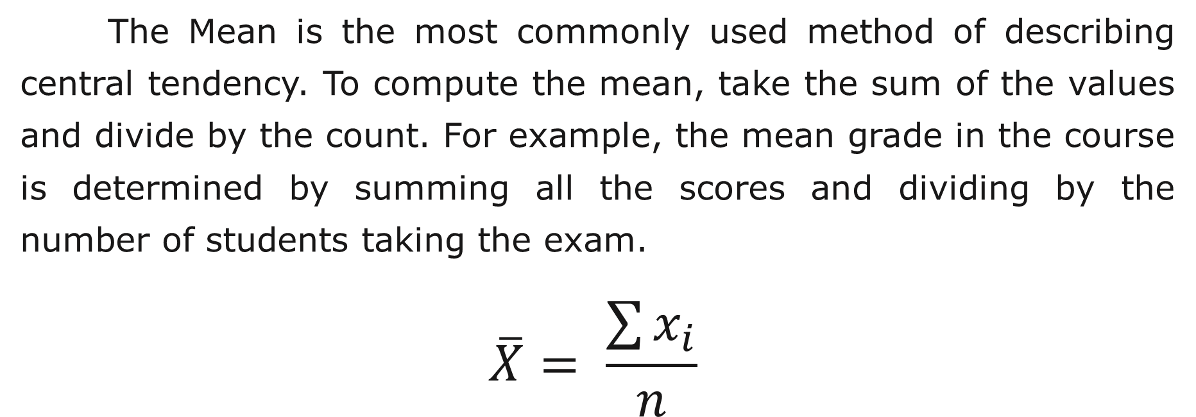
Mean
Data Analysis
Lecture 1
Descriptive Statistics
The Mean is the most commonly used method of describing central tendency. To compute the mean, take the sum of the values and divide by the count. For example, the mean grade in the course is determined by summing all the scores and dividing by the number of students taking the exam.
$$\overline{X}= \frac{\sum{x_{i}}}{n}$$

Slide 34
Dispersion
Data Analysis
Lecture 1
Descriptive Statistics
Dispersion is the spread of values around the central tendency. There are two common measures of dispersion, the range and the standard deviation. The range is calculated as the difference between the highest and the lowest value of the variable. The standard deviation is a more accurate and detailed estimate of dispersion because an outlier can greatly exaggerate the range (the single outlier value could stands apart from the rest of the values).

Slide 35
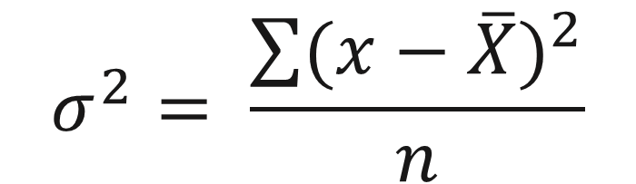
Variance
Data Analysis
Lecture 1
Descriptive Statistics
Variance is a measure of variability. It is calculated by taking the average of squared deviations from the mean. Variance tells you the degree of spread in your data set. The more spread the data, the larger the variance is in relation to the mean.
$$σ^{2}= \frac{\sum{{(x−\overline{X})}^{2}}}{n}$$

Slide 36
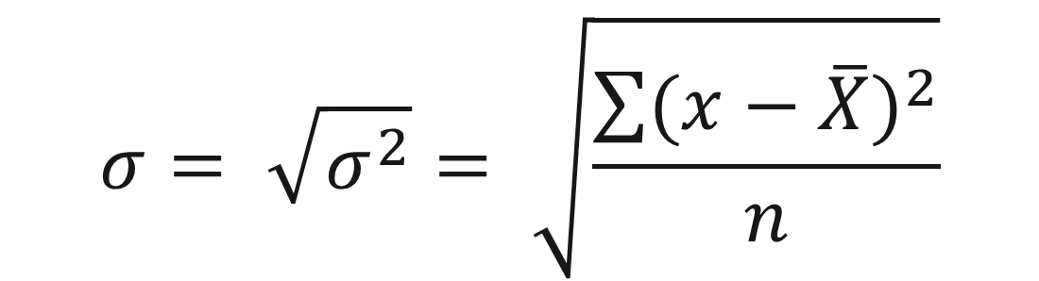
Standard Deviation
Data Analysis
Lecture 1
Descriptive Statistics
The standard deviation is a statistic that measures the dispersion of a dataset relative to its mean and is calculated as the square root of the variance. The standard deviation is expressed in the same unit of measurement as the data, which isn't the case with the variance.
$$σ= \sqrt{σ^{2}}= \sqrt{\frac{\sum{{(x−\overline{X})}^{2}}}{n}}$$

Slide 37
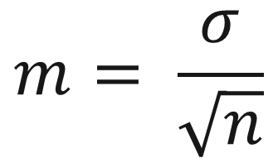
Standard Error of the Mean
Data Analysis
Lecture 1
Descriptive Statistics
A measure of how much the value of the mean may vary from sample to sample taken from the same distribution. Could be interpreted as a standard deviation of the means in different samples in relation to the mean of the population. If the figure is high we can conclude that mean of our sample is not an ideal representation of reality.
$$m= \frac{σ}{\sqrt{n}}$$

Slide 38
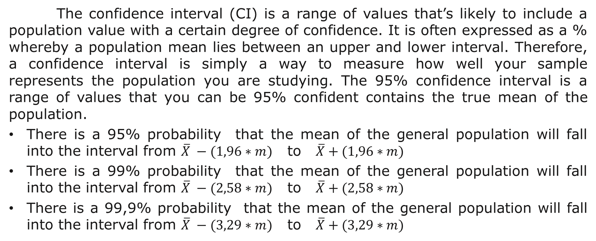
Сonfidence Interval
Data Analysis
Lecture 1
Descriptive Statistics
The confidence interval (CI) is a range of values that’s likely to include a population value with a certain degree of confidence. It is often expressed as a % whereby a population mean lies between an upper and lower interval. Therefore, a confidence interval is simply a way to measure how well your sample represents the population you are studying. The 95% confidence interval is a range of values that you can be 95% confident contains the true mean of the population.
There is a 95% probability that the mean of the general population will fall into the interval from $\overline{X} −(1,96∗m)$ to $\overline{X}+(1,96∗m)$
There is a 99% probability that the mean of the general population will fall into the interval from $\overline{X} −(2,58∗m)$ to $\overline{X}+(2,58∗m)$
There is a 99,9% probability that the mean of the general population will fall into the interval from $\overline{X} −(3,29∗m)$ to $\overline{X}+(3,29∗m)$

Slide 39
Median (second quartile / 50th percentile)
Data Analysis
Lecture 1
Descriptive Statistics
The median is the score found at the middle of the set of values. In order to compute the median sort the values in numerical order and then locate the value in the middle of the list.
For example, if there are 500 values, the median is the average of the two values in 250th and 251st positions. If there are 499 values, the value in 250th position is the median.
Let’s calculate the median of the following scores: 15, 20, 21, 20, 36, 15, 25, 15. Sorting the 7 scores produces: 15, 15, 15, 20, 21, 25, 36
There are 7 scores and score #4 represents the halfway point. The median is 20. If there are an even number of observations, then the median is the mean of the two middle scores. In the example, if there were an 8th observation, with a value of 25, the median becomes the average of the 4th and 5th scores, in this case 20.5.

Slide 40
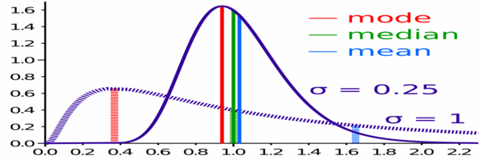
Mean or Median
Data Analysis
Lecture 1
Descriptive Statistics
When the mean and the median have values that are very close, it’s recommended to use the mean to describe the central tendency. When they are different, it’s better to use median.

Slide 41
Percentile Values
Data Analysis
Lecture 1
Descriptive Statistics
Values of a quantitative variable that divide the ordered data into groups so that a certain percentage is above and another percentage is below. Quartiles (the 25th, 50th, and 75th percentiles) divide the observations into four groups of equal size.
You can also specify individual percentiles (for example, the 95th percentile, the value below which 95% of the observations fall).

Slide 42
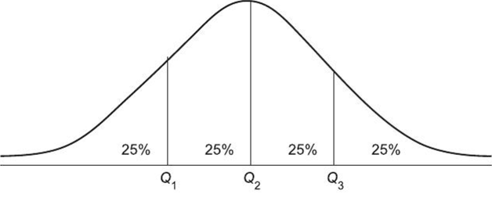
Quartile
Data Analysis
Lecture 1
Descriptive Statistics
Quartile divides the number of data points into four parts, or quarters, of more-or-less equal size. The data must be ordered from smallest to largest to compute quartiles. The three main quartiles are as follows:
The first quartile (Q1) is the 25th empirical percentile, as 25% of the data is below this point.
The second quartile (Q2) is the median of a data set; thus 50% of the data lies below this point.
The third quartile (Q3) is the 75th empirical percentile, as 75% of the data lies below this point.

Slide 43
Percentile-based data spread measures
Data Analysis
Lecture 1
Descriptive Statistics
Interquartile range is the difference between the third and first quartiles.
IQR = Q3 − Q1
Quartile deviation is half the difference between the upper and lower quartiles in a distribution (IQR/2). It is a measure of the spread through the middle half of a distribution. It can be useful because it is not influenced by extremely high or extremely low scores. Quartile Deviation is an ordinal statistic and is most often used in conjunction with the median.
Decile ratio is calculated as a ratio of the 10th decile to 1st decile. Income inter-decile ratios are used to evidence the disparities (or differences) between the richest and the poorest.

Slide 44
Select Data Spread Measure
Data Analysis
Lecture 1
Descriptive Statistics
If the mean is used to describe the central tendency, than the standard deviation or the variance should be used to describe the spread.
If the median is used to describe the central tendency, than the interquartile range or quartile deviation should be used to describe the spread.

Slide 45
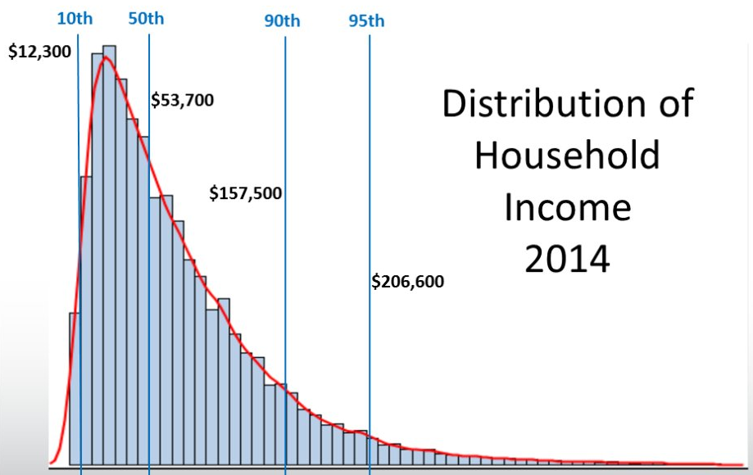
Decile Ratio: measuring inequality
Data Analysis
Lecture 1
Descriptive Statistics

Slide 46
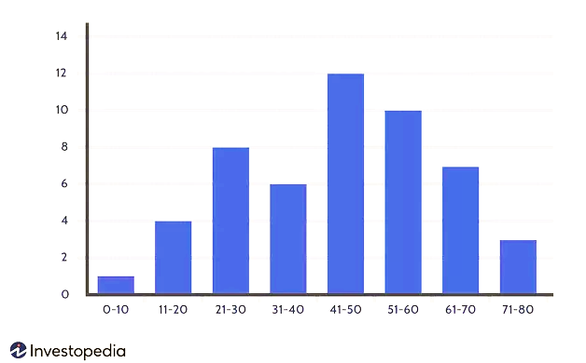
Histogram
Data Analysis
Lecture 1
Descriptive Statistics

Slide 47
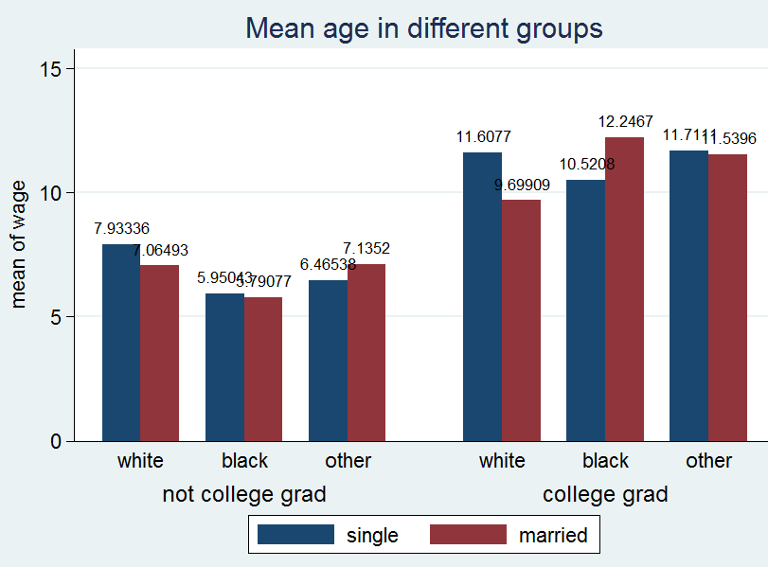
Bar chart (clustered)
Data Analysis
Lecture 1
Descriptive Statistics

Slide 48
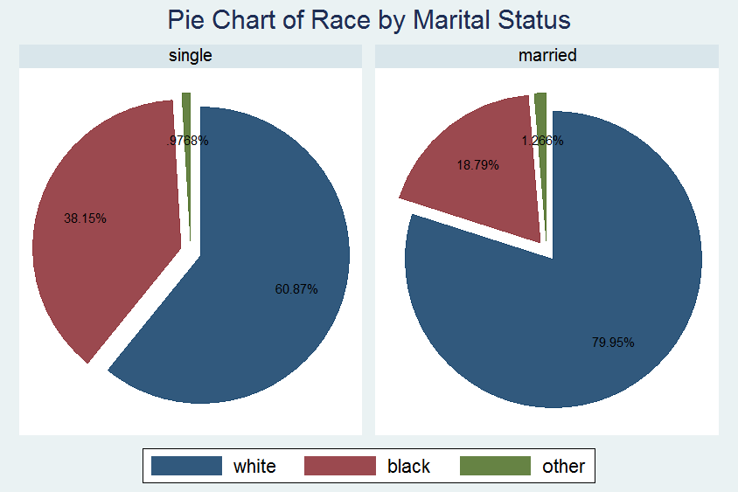
Data Analysis
Lecture 1
Descriptive Statistics

Slide 49
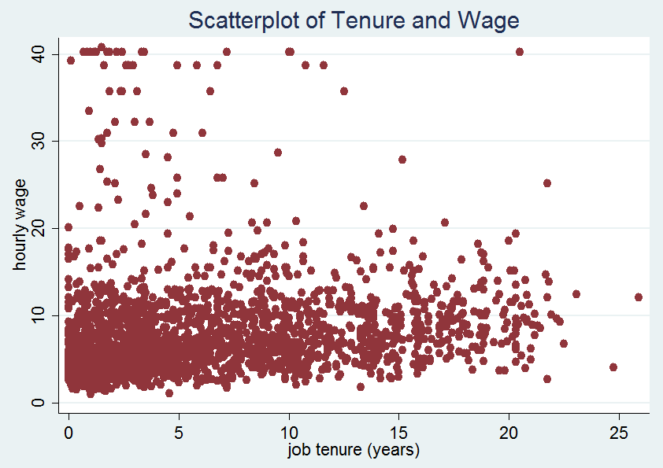
Scatterplot
Data Analysis
Lecture 1
Descriptive Statistics

Slide 50
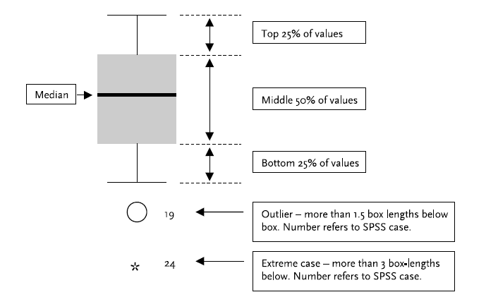
Boxplot
Data Analysis
Lecture 1
Descriptive Statistics

Slide 51
Boxplot
Data Analysis
Lecture 1
Descriptive Statistics
Boxplot illustrates the spread of the data:
• the shaded box contains the middle 50 per cent of values;
• the line inside the box depicts the median value;
• the T-bar lines above and below the box reach to the highest and lowest values.
Notice the added inclusion of ‘outliers’ and ‘extreme cases’ which often occur in large datasets. These cases deserve special attention since they may skew any measures of central tendency. For example, a couple of extremely high ages would have increased the mean value, leaving the median the same. Outliers and extreme cases may also, of course, simply indicate an error in data entry which sometimes occurs in large datasets.

Slide 52
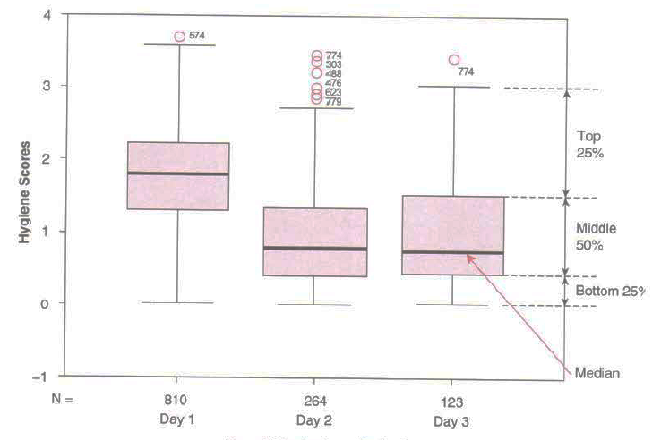
Clustered Boxplot
Data Analysis
Lecture 1
Descriptive Statistics

Slide 53
Normal Distribution
Data Analysis
Lecture 1
Descriptive Statistics
Frequency distributions come in many different shapes and sizes. In an ideal world the data would be distributed symmetrically around the center of all scores. This is known as a normal distribution and is characterized by the bell-shaped curve.
Note that Mean, Median and Mode are equal if the distribution is perfectly "normal" (i.e., bell-shaped).

Slide 54
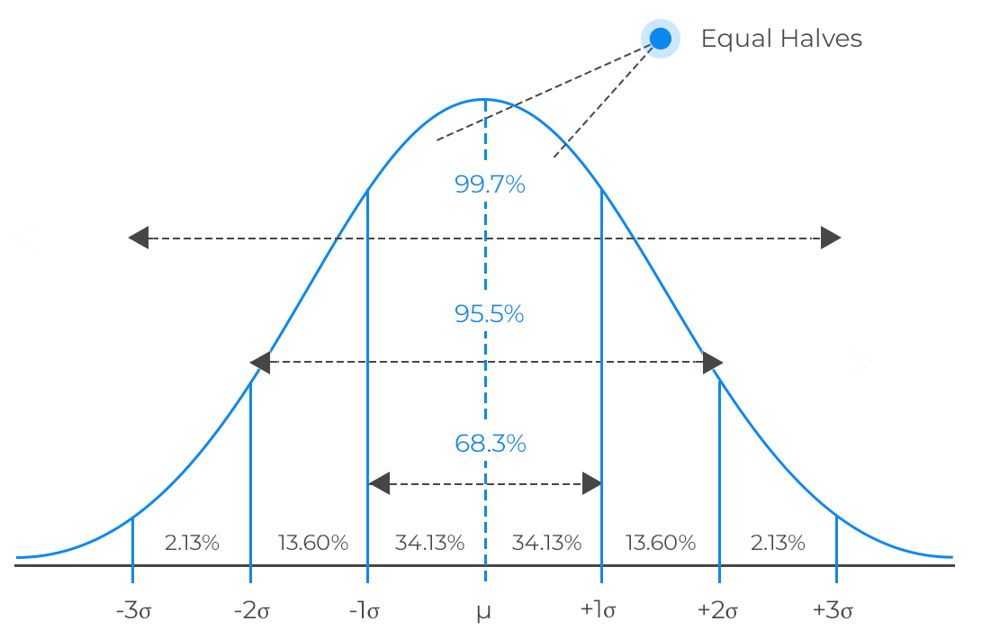
Normal Distribution
Data Analysis
Lecture 1
Descriptive Statistics

Slide 55



Other Distributions
Data Analysis
Lecture 1
Descriptive Statistics
Uniform distribution
Bimodal distribution
Skewed distribution

Slide 56
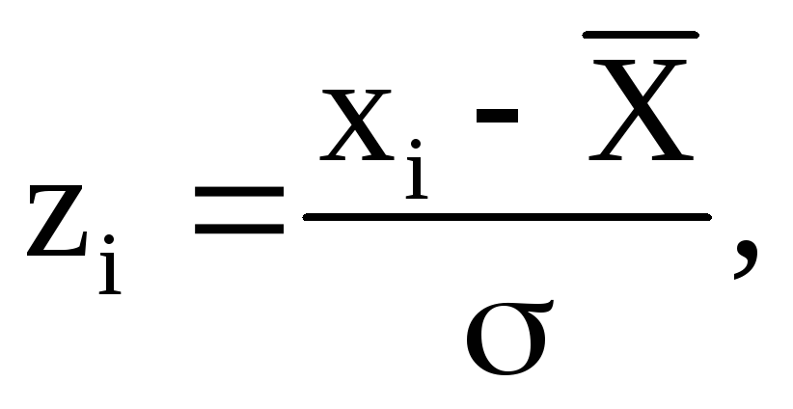
Z-Score Normalization
Data Analysis
Lecture 1
Descriptive Statistics
It’s possible to convert measures on very different scales, such as height and weight, into values that can be compared.
The mean of the standardized variable is 0 and the standard deviation is 1. Z-value is positive for observations that have a variable’s value above the mean, and negative if the values are below the mean.

Slide 57
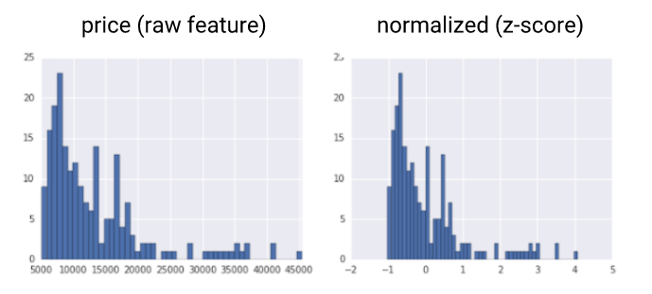
Z-Score Normalization
Data Analysis
Lecture 1
Descriptive Statistics

Slide 58
Skewness and Kurtosis
Data Analysis
Lecture 1
Descriptive Statistics
There are two main ways in which a distribution of a variable can deviate from normal:
Lack of simmetry (Skewness);
Pointyness (Kurtosis).
In the case of a normal distribution, the value of Skewness is 0, and the Kurtosis is 3.

Slide 59
Skewness
Data Analysis
Lecture 1
Descriptive Statistics
Skewed distributions are not symmetrical and instead the most frequent scores (the tall bars of the graph) are clustered at one end of the scale. These distributions could be either:
positively skewed (the frequent scores are clustered at the lower end and the tail points towards the higher or more positive scores) or
negatively skewed (the frequent scores are clustered at the higher end and the tail points towards the lower more negative scores).

Slide 60
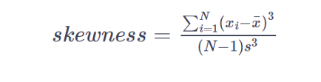
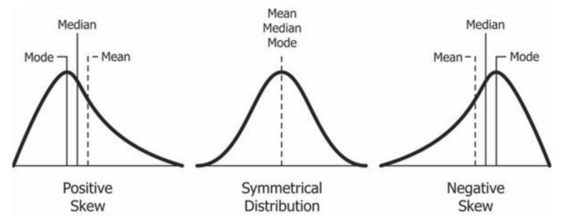
Skewness
Data Analysis
Lecture 1
Descriptive Statistics

Slide 61
Kurtosis
Data Analysis
Lecture 1
Descriptive Statistics
Distributions may also vary in their pointyness, or kurtosis which refers to the degree to which scores cluster in the tails of the distribution.
The leptokurtic distribution is relatively thin in the tails and so looks quite pointy (value of kurtosis is >3).
The platykurtic distribution is one that has many scores in the tails and so is quite flat.

Slide 62
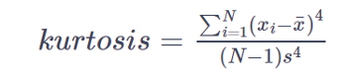
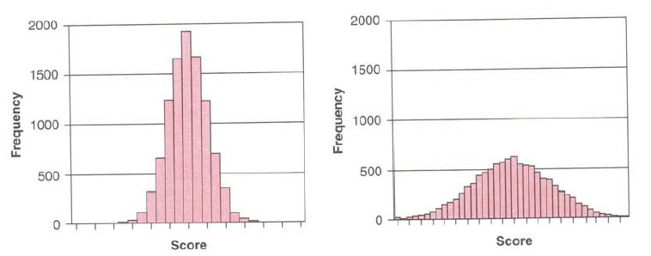
Kurtosis
Data Analysis
Lecture 1
Descriptive Statistics
Leptokurtic distribution (kurtosis > 3)
Platykurtic distribution
(kurtosis < 3)

Slide 63
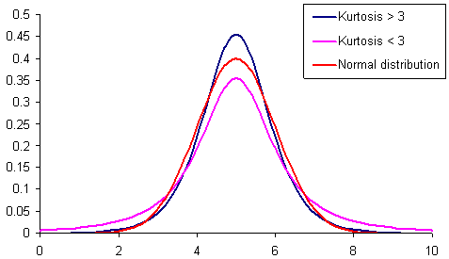
Kurtosis
Data Analysis
Lecture 1
Descriptive Statistics

Slide 64
Thank you for your attention!
Faculty of Computer Science
Data Analysis
Moscow 2022

